Slide 1
Day 04 - An Introduction to Multiple Processors
09/19/25

Slide 2
Today’s Topics
Supercomputer terminology
Pleasantly parallel problems
Running programs: processes & threads
Python on multiple CPU cores

Slide 3
CPU Block Model
Central Processing Unit
Control Unit (CU)
Arithmetic Logic Unit (ALU)
L1 Cache
Registers
Notes:
Revist model from Week 2

Slide 4
CPU Block Model
Central Processing Unit
Core
Control Unit (CU)
Arithmetic Logic Unit (ALU)
L1 Cache
Registers

Slide 5
Modern Multi-Core CPUs
Modern CPU
Central Processing Unit
Core
Core
Core
Core
Core
Control Unit (CU)
Arithmetic Logic Unit (ALU)
L2 Cache
L1 Cache
Registers
Controllers

Slide 6
Parts of a Computer
CPU
Main Memory (RAM)
Data Storage
Hard Disk Drive (HDD)
Solid State Drive (SSD)
Graphics Processing Unit (GPU)
Networking
Input devices (mouse, keyboard, etc)
Output devices (monitors, speakers, etc)
Other computers

Slide 7
A supercomputer is made of individual computers networked together to share a workload.
In this context, each computer is called a “node.”
Notes:
Modernly, anyway
Performance is a focus

Slide 8
Clusters
Nodes
CPU
GPU
Cores
Cores
RAM
Notes:
Clusters can be more than just supercomputers
Supercomputers require design for performance

Slide 9
From docs.icer.msu.edu/Cluster_Resources/
Cluster Type | Node Count | Processor | Cores | Memory | Disk Size | GPUs
amd20 | 207 | AMD EPYC 7H12 Processor | 128 | 493 GB | 412 GB | None
amd20-v100 | 20 | Intel Xeon Platinum 8260 CPU | 48 | 178 GB | 412 GB | 4 v100s
Notes:
Processor is used for CPU
Yes the amd20 cluster has Intel CPUs

Slide 10
Variable Terminology
“Processor” can refer to the CPU e.g. the AMD EPYC Processor
“Processor” can refer to CPU cores e.g. “Run this code with multiple processors”
“CPUs” can also refer to the cores e.g. the SLURM option “mem-per-cpu”
Notes:
We’re almost never going to use the first meaning
I will try to stick with cores

Slide 11
Using Multiple Cores
Sharing work is a powerful way to shorten program runtime.
Pleasantly parallel problems are those workloads that can be easily split over multiple cores with little change.
Examples:
Multiple images need preprocessing before training machine learning
Years worth of voting data needs correlating with population statistics for multiple counties
A Monte Carlo simulation needs hundreds of realizations to adequately investigate statistics
Consider: how would you distribute these workloads across multiple cores?

Slide 12
How do we accomplish parallelization in Python?

Slide 13
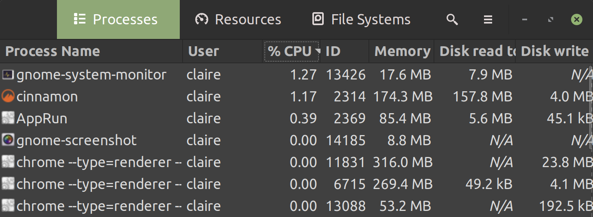
What is a Process?
Processors process processes :)
A “process” is an instance of a computer program
Processes can create other processes! (see: chrome)

Slide 14
What is a Thread?
If you’ve taken CMSE 822 or worked with OpenMP, you’ve probably heard of “threading”
Every process has at least one thread.
Threads execute the program in schedulable segments.
Multiple threads for the same process share memory
Multiple CPU cores, each running a thread of the same process, can make that process run faster.
Notes:
Recall: CPU is trading off tasks
a thread of execution is the smallest sequence of programmed instructions that can be managed independently by a scheduler

Slide 15
Processes | Threads
Instance of a program | Executes segment of process
Isolated memory | Shared memory
One system call per process created | One system call can create multiple threads
More time to create, destroy, and switch between | Less time to create, destroy, and switch between
“heavy-weight” | “light-weight”
Threads sound great for performance! Can we use them in Python?
Maybe introduce with Numba when actually relevant

Slide 16
Python’s Global Interpreter Lock
Python uses reference counting to track when memory can be freed
To prevent errors, only one thread at a time may update thread may update the reference count - this is the GIL
Though threads provide many advantages (speed, shared memory), the GIL restricts situations in which they improve performance
Exception: performing tasks while waiting for I/O (covered in ~a month)
For most cases, we must use multiple processes to leverage multiple cores
The GIL can experimentally be removed in Python 3.13 if you build Python from its source code (which I have not)

Slide 17
Python’s Multiprocessing Module
A module in the Python standard library (always available with Python)
Convenient way to divide a workload across multiple processes.
These processes treat their data with the same function.
Parent Process
Child Process
Child Process
Time

Slide 18
Using Multiprocessing
The most helpful object in the multiprocessing module is Pool.
Pool.map() automatically divides a workload and applies a function:
with multiprocessing.Pool(processes=ncores) as p: p.map(function, data)
Our program will run most efficiently if we have one process per core.
Why is it bad for performance to have more processes than available cores?
Notes:
Using a context manager

Slide 19
